Slide 1






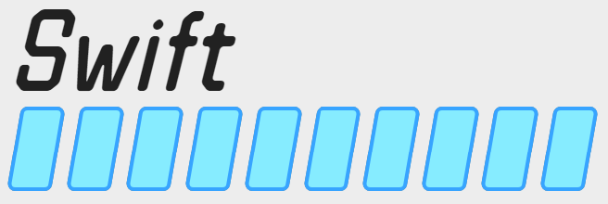

Ben Leggiero
Developer | Designer
.
Software Engineer III with a passion for making great products
BenLeggiero@Gmail.com +1 (470) BEN C LEG (236-2534)
Employment
Ionic Security (2017 – present)
macOS Software Engineer
Architecting user-facing file encryption and access software for macOS. Collaborate on a company-wide software platform to allow such client software to be made consistent on many other platforms, including macOS, Android, Windows, and iOS.
Working closely with UI/UX team to hone the design of multiple company products, including graphics, animations, user flows, and overall experience.
Renewed Vision (2016 – 2017)
macOS Software Engineer
Built industry-leading professional presentation software for macOS. Collaboratively created software platforms with open-source & proprietary tech: advanced auto font scaling, inspector, & animated grid item selector.
Designed dozens of icons & other graphics, user flows, interface approaches, animations, and more.
NCR — Small & Medi­um Busi­ness (2016 – 2017)
Mobile Software Engineer
Built state-of-the-art point-of-sale software for iOS & Android. Implemented headlining features such as 64-bit support, EMV payments, scale-weighing of items, & future orders, including any hardware drivers necessary for these.
Worked alongside UI design team to revamp the system's look-and-feel.
University System of Georgia Information Technology Services (2012 – 2014)
Web Developer & Designer
Redesigned & rebuilt ColumbusState.edu and dozens of sub-sites in HTML5+CSS3, with XSLT & PHP where needed. Made templates for CMS so teachers could build pages.
Invented, critiqued, and evolved design elements for CSU website. Designed pages for all schools of the University within a consistent theme.
Swift
Kotlin
HTML 5
CSS 4
SASS
macOS
iOS
Android
Tech Specs
JVM
Web - font
Web - back
Multithreading
Education
Networking
Git
Open-Source
Architecture
Swift
macOS
Multithreading
Kotlin
Agile
iOS
Learning New Skills
Networking
Columbus State University (2014)
Bachelor of Science in Computer Science
HTML 5
Android
Git
Design
CSS 4
JVM
Open-Source
SASS
Web - font
Architecture
UI/UX
Icons
Web
Print
Learning New Skills
Web - back
Agile
Logos
Sketch
Inkscape
Gravit
https://Resume.BenLeggiero.me
Swift
Last Updated 2019-03-28
Notes Feel free to write your notes here

